Slide 1
Learning Systems
Research at the Intersection of Machine Learning & Data Systems
Joseph E. Gonzalez
Asst. Professor, UC Berkeley
jegonzal@cs.berkeley.edu

Slide 2
How can machine learning techniques be used to address systems challenges?
Learning Systems
How can systems techniques be used to address machine learning challenges?

Slide 3
How can machine learning techniques be used to address systems challenges?
Learning Systems
How can systems techniques be used to address machine learning challenges?

Slide 4
How can machine learning techniques be used to address systems challenges?
Systems are getting increasing complex:
Resource Disaggregation → growing diversity of system configurations and freedom to add resources as needed
New Pricing Models → dynamic pricing and potential to bid for different types of resources
Data-centric Workloads → performance depends on interaction between system, algorithms, and data

Slide 5
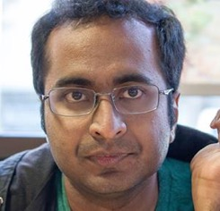
Paris Performance Aware Runtime Inference System
Neeraja Yadwadkar
Bharath
Hariharan
Randy Katz
What vm-type should I use to run my experiment?
r3.2xlarge
m4.large
r3.xlarge
c4.large
t2.large
m4.4xlarge
r3.large
m3.xlarge
g2.8xlarge
m4.2xlarge
g2.2xlarge
m3.2xlarge
m3.medium
t2.micro
c4.xlarge
c4.2xlarge
m3.large
r3.8xlarge
c4.4xlarge
r3.4xlarge
c4.8xlarge
t2.small
m4.xlarge
x1.32xlarge
t2.medium
t2.nano
m4.10xlarge

Slide 6
Paris Performance Aware Runtime Inference System
Neeraja Yadwadkar
Bharath
Hariharan
Randy Katz
What vm-type should I use to run my experiment?
r3.2xlarge
m3.xlarge
g2.2xlarge
m4.2xlarge
c4.large
t2.large
m4.large
m4.4xlarge
r3.xlarge
r3.large
m3.medium
g2.8xlarge
54
Instance Types
t2.micro
m3.large
r3.4xlarge
m3.2xlarge
r3.8xlarge
c4.2xlarge
c4.4xlarge
c4.8xlarge
m4.xlarge
t2.small
c4.xlarge
x1.32xlarge
t2.medium
t2.nano
m4.10xlarge

Slide 7
Paris Performance Aware Runtime Inference System
Neeraja Yadwadkar
Bharath
Hariharan
Randy Katz
What vm-type should I use to run my experiment?
Answer: workload specific and depends on cost & runtime goals
c4.large
r3.large
m4.large
t2.small
t2.micro
t2.large
r3.xlarge
m4.2xlarge
c4.4xlarge
m3.xlarge
m3.large
g2.2xlarge
r3.8xlarge
c4.8xlarge
g2.8xlarge
t2.medium
m4.10xlarge
c4.2xlarge
m4.xlarge
c4.xlarge
m3.medium
t2.nano
r3.4xlarge
m3.2xlarge
x1.32xlarge
m4.4xlarge
r3.2xlarge
54
25
18

Slide 8
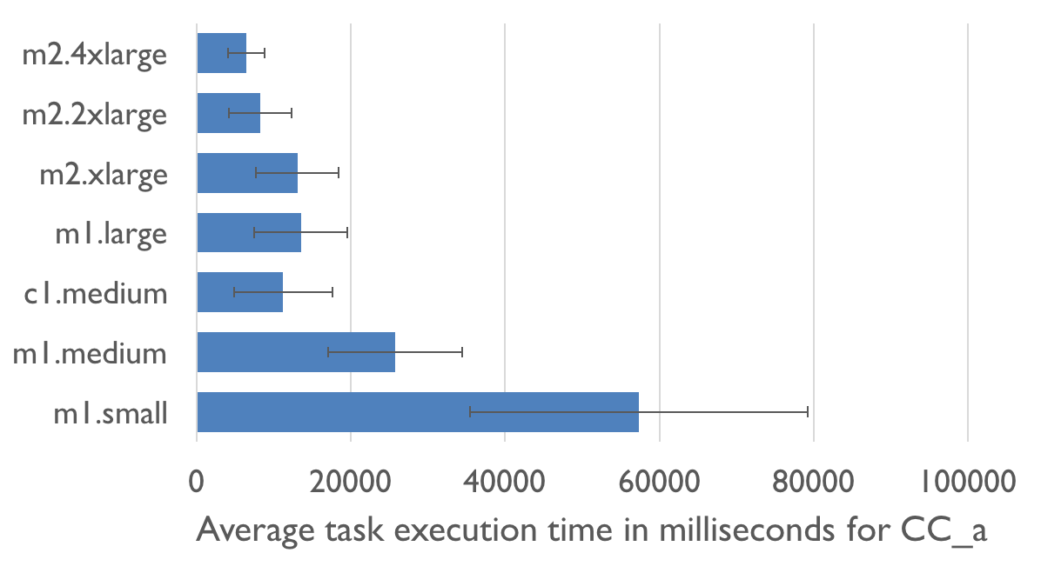
Paris Performance Aware Runtime Inference System
Neeraja Yadwadkar
Bharath
Hariharan
Randy Katz
Best vm-type depends on workload as well as cost & runtime goals
Which VM will cost me the least?
Price
Runtime
m1.small is cheapest?

Slide 9
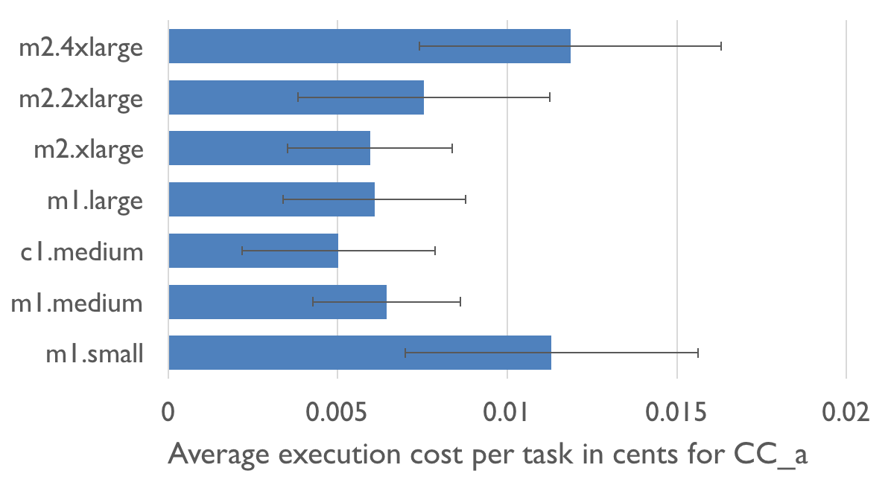
Paris Performance Aware Runtime Inference System
Neeraja Yadwadkar
Bharath
Hariharan
Randy Katz
Best vm-type depends on workload as well as cost & runtime goals
Price
Job Cost
Runtime
Requires accurate runtime prediction.

Slide 10
Paris Performance Aware Runtime Inference System
Neeraja Yadwadkar
Bharath
Hariharan
Randy Katz
Goal: Predict the runtime of workload w on VM type v
Challenge: How do we model workloads and VM types
Insight:
Extensive benchmarking to model relationships between VM types
Costly but run once for all workloads
Lightweight workload “fingerprinting” by on a small set of test VMs
Generalize workload performance on other VMs
Results: Runtime prediction 17% Relative RMSE (56% Baseline)
Benchmarking
…
vm1
vm2
vm100
Fingerprinting
Workload

Slide 11



Hemingway* Modeling Throughput and Convergence for ML Workloads
Shivaram
Venkataraman
Xinghao
Pan
Zi
Zheng
What is the best algorithm and level of parallelism for an ML task?
Trade-off: Parallelism, Coordination, & Convergence
Research challenge: Can we model this trade-off explicitly?
ML Metric
We can estimate I from data on many systems
Iter. / Sec.
Loss
p=1
Systems Metric
We can estimate L from data for our problem
p=4
Cores
Iteration
Iterations per second as a function of cores p
Loss as a function of iterations i and cores p
*follow-up work to Shivaram’s Ernest paper
Notes:
more parallelism doesn’t not imply faster learning
can depend on loss and properties of the data

Slide 12
Hemingway* Modeling Throughput and Convergence for ML Workloads
Shivaram
Venkataraman
Xinghao
Pan
Zi
Zheng
What is the best algorithm and level of parallelism for an ML task?
Trade-off: Parallelism, Coordination, & Convergence
Research challenge: Can we model this trade-off explicitly?
Loss as a function of iterations i and cores p
Iterations per second as a function of cores p
How long does it take to get to a given loss?
Given a time budget and number of cores which algorithm will give the best result?
*follow-up work to Shivaram’s Ernest paper
Notes:
more parallelism doesn’t not imply faster learning
can depend on loss and properties of the data

Slide 13

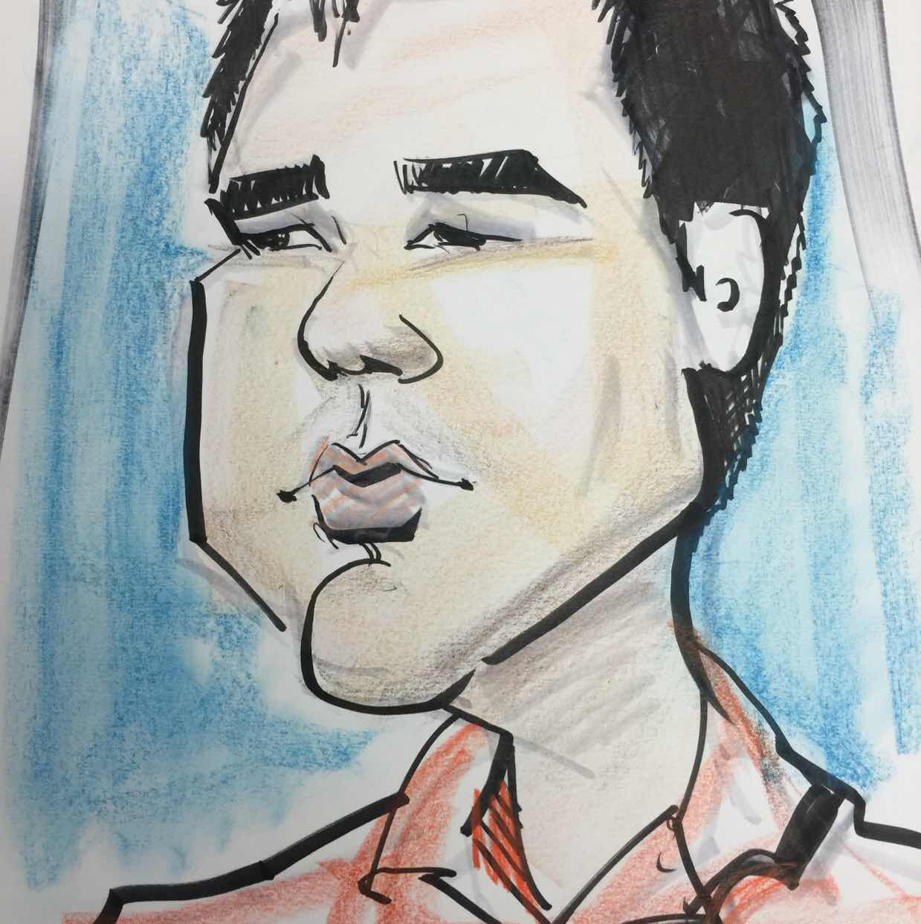

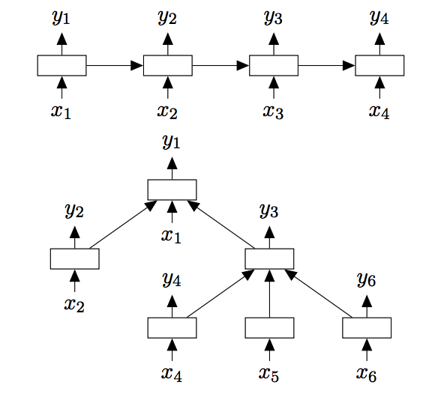
Deep Code Completion Neural architectures for reasoning about programs
Goals:
Smart naming of variables and routines
Learn coding styles and patterns
Predict large code fragments
Char and Symbol LSTMs
Programs are more tree shaped…
Xin
Wang
Chang
Liu
Dawn
Song
def fib( ):
x
if
x < 2
:
return x
else:
y
=
fib(x–1)
+
fib(x–2)
return y
Notes:
more parallelism doesn’t not imply faster learning
can depend on loss and properties of the data

Slide 14
Deep Code Completion Neural architectures for reasoning about programs
Goals:
Smart naming of variables and routines
Learn coding styles and patterns
Predict large code fragments
Char and Symbol LSTMs
Programs are more tree shaped…
Xin
Wang
Chang
Liu
Dawn
Song
def fib( ):
x
Parse
Tree
if
x < 2
return x
=
y
+
fib(x–1)
fib(x–2)
return y
Notes:
Improved Semantic Representations From Tree-Structured Long Short-Term Memory Networks
Kai Sheng Tai, Richard Socher, Christopher D. Manning

Slide 15
Deep Code Completion Neural architectures for reasoning about programs
Goals:
Smart naming of variables and routines
Learn coding styles and patterns
Predict large code fragments
Char and Symbol LSTMs
Exploring Tree LSTMs
Issue: dependencies flow in both directions
Xin
Wang
Chang
Liu
Dawn
Song
def fib( ):
x
Parse
Tree
if
x < 2
return x
=
y
+
fib(x–1)
fib(x–2)
return y
Kai Sheng Tai, Richard Socher, Christopher D. Manning. “Improved Semantic Representations From Tree-Structured Long Short-Term Memory Networks.” (ACL 2015)
Notes:
Improved Semantic Representations From Tree-Structured Long Short-Term Memory Networks
Kai Sheng Tai, Richard Socher, Christopher D. Manning

Slide 16
Deep Code Completion Neural architectures for reasoning about computer programs
Goals:
Smart naming of variables and routines
Learn coding styles and patterns
Predict large code fragments
Current studying Char-LSTM and Tree-LSTM on benchmark C++ code and JavaScript code.
Plan to extend Tree-LSTM with downward information flow
Xin
Wang
Chang
Liu
Dawn
Song
Vanilla LSTM
Tree- LSTM
Notes:
more parallelism doesn’t not imply faster learning
can depend on loss and properties of the data

Slide 17
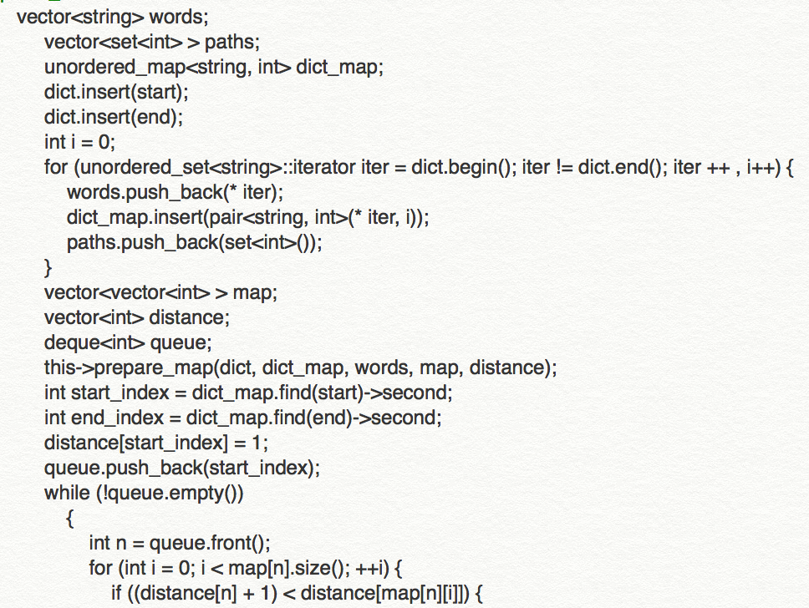
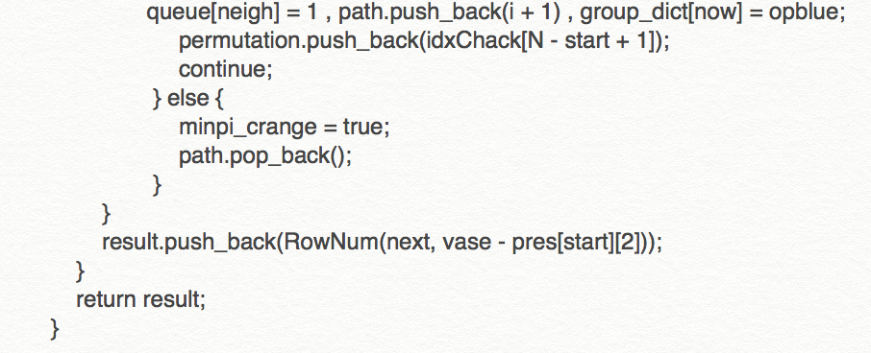
Fun Code Sample Generated by Char-LSTM
Code Prefix
Generated Code Sample
For now, the neural network can learn some code patterns like matching the parenthesis, if-else block, etc but the variable name issue still hasn’t been solved.
*this is trained on the leetcode OJ code submissions
from Github.

Slide 18
How can machine learning techniques be used to address systems challenges?
Learning Systems
How can systems techniques be used to address machine learning challenges?

Slide 19
How can machine learning techniques be used to address systems challenges?
Learning Systems
How can systems techniques be used to address machine learning challenges?

Slide 20
Systems for Machine Learning
Big
Data
Training
Big Model
Timescale: minutes to days
Systems: offline and batch optimized
Heavily studied ... primary focus of the ML research

Slide 21
Learning
Big
Data
Training
Big Model
Please make a Logo!

Slide 22
Learning
Big
Data
Training
Big Model
emgine
Please make a Logo!

Slide 23


Temgine A Scalable Multivariate Time Series Analysis Engine
Challenge:
Estimate second order statistics
E.g. Auto-correlation, auto-regressive models, …
for high-dimensional & irregularly sampled time series
Francois
Billetti
Evan
Sparks
Xin
Wang
Regularly
Sampled
Irregularly
Sampled
Samples are easy to align (requires sorting)
Difficult to align!

Slide 24
Temgine A Scalable Multivariate Time Series Analysis Engine
Challenge:
Estimate second order statistics
E.g. Auto-correlation, auto-regressive models, …
for high-dimensional & irregularly sampled time series
Francois
Billetti
Evan
Sparks
Xin
Wang
Regularly
Sampled
Irregularly
Sampled
Solution:
Project onto Fourier basis
does not require data alignment
Infer statistics in frequency domain
equivalent to kernel smoothing
analysis of bias – variance tradeoff
Samples are easy to align (requires sorting)
Difficult to align!

Slide 25
Temgine A Scalable Multivariate Time Series Analysis Engine
Challenge:
Estimate second order statistics
E.g. Auto-correlation, auto-regressive models, …
for high-dimensional & irregularly sampled time series
Francois
Billetti
Evan
Sparks
Xin
Wang
Regularly
Sampled
Solution:
Project onto Fourier basis
does not require data alignment
Infer statistics in frequency domain
equivalent to kernel smoothing
analysis of bias – variance tradeoff
Irregularly
Sampled
emgine
Difficult to align!
Requires aligning samples in time to compute correlation
Define an operator DAG (like TF) and then rely on query-optimization to define efficient execution.

Slide 26
Learning
Big
Data
Training
Big Model

Slide 27
Learning
Inference
Big
Data
Query
Training
?
Decision
Big Model
Application

Slide 28
Inference
Learning
Query
Big
Data
Training
Decision
Big Model
Application
Timescale: ~10 milliseconds
Systems: online and latency optimized
Less Studied …

Slide 29
why is challenging?
Inference
Need to render low latency (< 10ms) predictions for complex
Models
Queries
Features
SELECT * FROM
users JOIN items, click_logs, pages WHERE …
Top K
under heavy load with system failures.

Slide 30
Inference
Learning
Claim:
next big area of research in scalable ML systems
Query
Big
Data
Training
Decision
Big Model
Application
Timescale: ~10 milliseconds
Systems: online and latency optimized
Less studied …

Slide 31
Learning
Inference
Big
Data
Query
Training
Decision
Big Model
Application
Feedback

Slide 32
Learning
Inference
Training
Decision
Big
Data
Timescale: hours to weeks
Issues: No standard solutions …
implicit feedback, sample bias, …
Application
Feedback

Slide 33
Why is challenging?
Feedback
Exposes system to feedback loops
Address Explore – Exploit trade-off in real-time
Adverserial feedback
Opportunities for multi-task learning and anomly detection
Need to address temporal variation
Need to model time directly? When do we forget the past?
Notes:
Combines multiple systems with different design goals
Tradeoff latency vs throughput

Slide 34
Learning
Inference
Big
Data
Query
Training
Decision
Big Model
Application
Feedback

Slide 35
Learning
Inference
Big
Data
Query
Training
Responsive
(~10ms)
Adaptive
(~1 seconds)
Decision
Big Model
Application
Feedback
Notes:
Adaptive is hard because of the complex training process that typically revisits the entire data set.
Responsive is hard because of complex often personalized models a elaborate queries

Slide 36
Learning
Inference
Adaptive
(~1 seconds)
Responsive
(~10ms)
Techniques we are studying (or should be …):
Multi-task
Learning
Adaptive
Batching
Approx.
Caching
Anytime
Inference
Model
Switching
Meta-Policy
RL
Online Ensemble
Learning
Load Shedding
Model
Compression
Inference on the Edge
Notes:
Adaptive is hard because of the complex training process that typically revisits the entire data set.
Responsive is hard because of complex often personalized models a elaborate queries

Slide 37
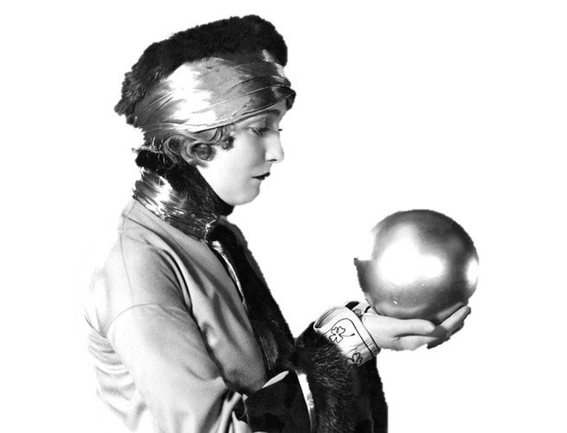

Prediction Serving
Daniel
Crankshaw
Xin
Wang
Giulio
Zhou
Michael
Franklin
Ion Stoica

Slide 38
Learning
Inference
Big
Data
Query
Training
Decision
Application
Feedback

Slide 39
Learning
Inference
Slow Changing
Parameters
Fast Changing Parameters
Big
Data
Query
Feedback
Training
Fast
Decision
Application
Feedback
Slow

Slide 40
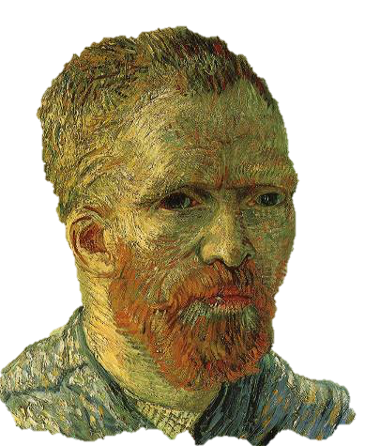
Hybrid Offline + Online Learning
Update feature functions offline using batch solvers
Leverage high-throughput systems (Tensor Flow)
Exploit slow change in population statistics
Update the user weights online:
Simple to train + more robust model
Address rapidly changing user statistics

Slide 41
Common modeling structure
Matrix Factorization
Deep Learning
Ensemble
Methods
Items
Users
Ratings
Input

Slide 42
Clipper Online Learning for Recommendations (Simulated News Rec.)
Partial Updates: 0.4 ms
Retraining: 7.1 seconds
>4 orders-of-magnitude faster adaptation
Error
Partial Updates
Full Updates
Examples

Slide 43
Learning
Inference
Big
Data
Slow Changing
Parameters
Fast Changing Parameters
Feedback
Fast
Application
Feedback
Slow

Slide 44
Learning
Inference
Slow Changing
Parameters
Clipper
Fast Changing Parameters
Big
Data
Feedback
Fast
Caffe
Application
Feedback
Slow

Slide 45
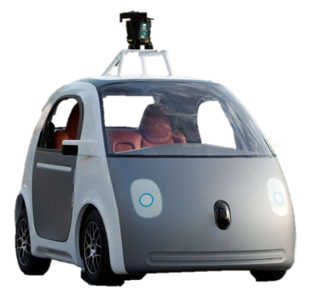

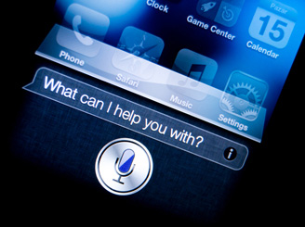






Clipper Serves Predictions across ML Frameworks
Fraud Detection
Content
Rec.
Personal
Asst.
Robotic
Control
Machine
Translation
Clipper
VW
Create
Caffe

Slide 46
Clipper Architecture
Applications
Predict
RPC/REST Interface
Observe
Clipper
VW
Create
Caffe

Slide 47
Clipper Architecture
Applications
Predict
RPC/REST Interface
Observe
Clipper
RPC
RPC
RPC
RPC
Model Wrapper (MW)
MW
MW
MW
Caffe
VW
Create
Notes:
Jump to slide 61

Slide 48
Clipper Architecture
Applications
Predict
RPC/REST Interface
Observe
Clipper
Improve accuracy through ensembles, online learning and personalization
Model Selection Layer
Model Abstraction Layer
Provide a common interface to models
while bounding latency and maximizing throughput.
RPC
RPC
RPC
RPC
Model Wrapper (MW)
MW
MW
MW
Caffe
Notes:
Jump to slide 61

Slide 49
Clipper Architecture
Applications
Predict
RPC/REST Interface
Observe
Clipper
Model Selection Layer
Anytime Predictions
Model Abstraction Layer
Approximate Caching
Adaptive Batching
RPC
RPC
RPC
RPC
Model Wrapper (MW)
MW
MW
MW
Caffe
Notes:
Jump to slide 61

Slide 50
Adaptive Batching to Improve Throughput
Why batching helps:
Optimal batch depends on:
hardware configuration
model and framework
system load
Clipper Solution:
be as slow as allowed…
Application specifies latency objective
Clipper uses TCP-like tuning algorithm to increase latency up to the objective
A single
page load may generate
many queries
Hardware
Acceleration
Helps amortize
system overhead

Slide 51
Tensor Flow Conv. Net (GPU)
Optimal Batch Size
Throughput
Latency (ms)
P99 Latency
Throughput (Queries Per Second)
Latency
Deadline
Avg. Latency
Batch Sizes (Queries)

Slide 52
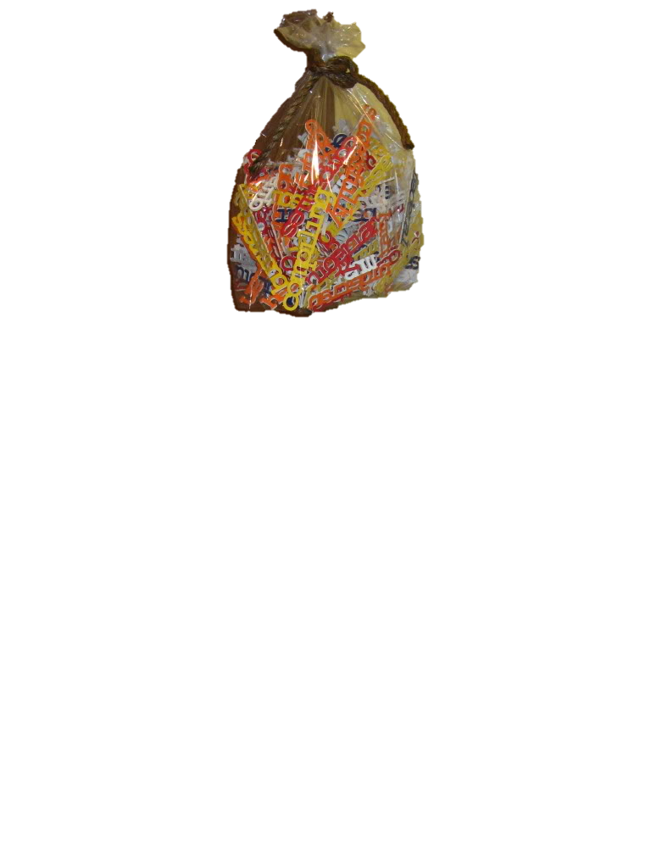
Approximate Caching to Reduce Latency
Opportunity for caching
Need for approximation
Clipper Solution: Approximate Caching
apply locality sensitive hash functions
Popular items may be evaluated frequently
Cache Hit
Hash 1
?
Hash 2
Cache Miss
Bag-of-Words
Model
?
Images
Cache Hit
?
Error
High Dimensional and continuous valued queries have low cache hit rate.

Slide 53
Adaptive Batching to Improve Throughput
Why batching helps:
Optimal batch depends on:
hardware configuration
model and framework
system load
Clipper Solution:
be as slow as allowed…
Application specifies latency objective
Clipper uses TCP-like tuning algorithm to increase latency up to the objective
A single
page load may generate
many queries
Hardware
Acceleration
Helps amortize
system overhead

Slide 54
Tensor Flow Conv. Net (GPU)
Optimal Batch Size
Throughput
Latency (ms)
P99 Latency
Throughput (Queries Per Second)
Latency
Deadline
Avg. Latency
Batch Sizes (Queries)

Slide 55
Anytime Predictions
Slow Changing
Model
Clipper
✓
20ms
Fast Changing Linear Model
✓
Application
Caffe
Solution:
Replace missing prediction with an estimator
E[ (x) ]
Notes:
Skip to 61 if needed

Slide 56
Anytime Predictions
Fast Changing Model
w_{scikit}
+
w_{TF}
+
w_{Caffe}
✓
✓
Slow Changing
Model
Caffe
Notes:
Skip to 48 if needed

Slide 57
Comparison to TensorFlow Serving
Takeaway: Clipper is able to match the average latency of TensorFlow Serving while reducing tail latency (2x) and improving throughput (2x)
Notes:
to get a sense to how we perform, we compared to google’s tensor flow serving
use same code as google, expect to get similar performance
see similar latencies, but clipper is able to ensure a more consistent latency
now if we look at throughput, see substantial improvement in throughput, more adaptive

Slide 58
Evaluation of Throughput Under Heavy Load
Accuracy
Throughput (queries per second)
Takeaway: Clipper is able to gracefully degrade accuracy to maintain availability under heavy load.
Notes:
Experiments on digits using Spark SVMs

Slide 59
Improved Prediction Accuracy (ImageNet)
System | Model | Error Rate | #Errors
Caffe | VGG | 13.05% | 6525
Caffe | LeNet | 11.52% | 5760
Caffe | ResNet | 9.02% | 4512
TensorFlow | Inception v3 | 6.18% | 3088
sequence of pre-trained models
Notes:
ImageNet public validation dataset (50K examples)
1000 categories

Slide 60
Improved Prediction Accuracy (ImageNet)
System | Model | Error Rate | #Errors
Caffe | VGG | 13.05% | 6525
Caffe | LeNet | 11.52% | 5760
Caffe | ResNet | 9.02% | 4512
TensorFlow | Inception v3 | 6.18% | 3088
Clipper | Ensemble | 5.86% | 2930
5.2% relative improvement in prediction accuracy!
Notes:
ImageNet public validation dataset (50K examples)

Slide 61
Clipper prediction serving system that spans multiple ML Frameworks and is designed to
Clipper
Caffe
VW
Create
to simplifying model serving
bound latency and increase throughput
and enable real-time learning and personalization
across machine learning frameworks

Slide 62
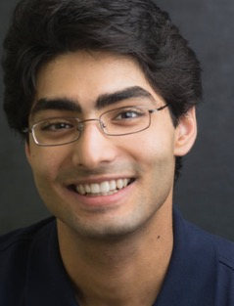
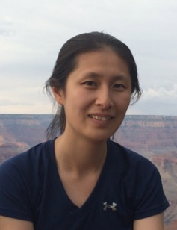
Learning Systems
Joseph E. Gonzalez
773 Soda Hall
jegonzal@cs.berkeley.edu
Graduate students collaborators on this work:
Francois
Billetti
Daniel
Crankshaw
Ankur
Dave
Xinghao
Pan
Xin
Wang
Neeraja
Yadwadkar
Wenting
Zheng

Slide 63
R SE
Real-time, Intelligent, and Secure
Systems Lab

Slide 64
RISE Lab
From live data to real-time decisions
AMP Lab
From batch data to advanced analytics

Slide 65
Goal
Real-time decisions
decide in ms
on live data
the current state as data arrives
with strong security
privacy, confidentiality, and integrity
decide in ms
the current state of the environment
privacy, confidentiality, integrity

Slide 66
R SE
Real-time, Intelligent, and Secure
Systems Lab
Learn More:
CS294 Course on RISE Topics
https://ucbrise.github.io/cs294-rise-fa16/
Early RISErs Seminar on Mondays at 9:30 AM

Slide 67
Security: Protecting Models
Data is a core asset & models capture the value in data
Expensive: many engineering & compute hours to develop
Models can reveal private information about the data
How do we protect models from being stolen?
Prevent them from being copied from devices (DRM? SGX?)
Defend against active learning attacks on decision boundaries
How do we identify when models have been stolen?
Watermarks in decision boundaries?

